Slide 1
Optimizing the Technology Value Stream
Arely Gil
May 29, 2025

Slide 2

Understanding the technology value stream
Definition: The technology value stream includes all processes involved in turning a business requirement or customer into a deployed software solution.
Purpose:
Detect process delays and performance gaps
Enhance the speed and quality of software delivery
Promote alignment between development, operations, and business goals

Slide 3


Lead time vs processing time
Lead Time: The total duration from the moment a change is requested to the moment deployed into production.
Processing Time: The actual time spent actively working on the change, excluding any delays or waiting periods.
Waiting in line
On the roller-coaster ride
VS

Slide 4
Traditional Challenges – Lengthy Deployment Lead Times
Common Pre-DevOps Issues:
Lengthy approval processes
Manual testing and release practices
Poor communication between teams
High-risk, infrequent releases
These practices often resulted in deployment lead times spanning several months.

Slide 5
The DevOps Ideal – Deployments in Minutes
Modern DevOps Practices Enable:
Automated pipelines for building, testing, and deployment
Smaller, incremental code changes
Real-time monitoring and feedback
Collaborative, cross-functional teams
These practices reduce deployment lead times from months to minutes.

Slide 6
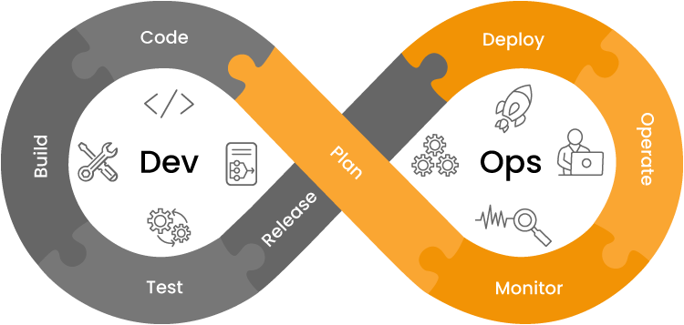
Visualizing the Value Stream
Diagram: A visual representation of the flow from idea to deployment, such as:
Plan → Code → Build → Test → Release → Deploy → Operate→ Monitor
Why It Matters:
Reveals inefficiencies and handoffs
Clarifies the sequence of activities
Helps teams target high-impact improvements
Enables data-driven decisions to streamline delivery
A well-constructed visual helps stakeholders understand how value is delivered and where the greatest opportunities lie.

Slide 7

Key DevOps Metrics for Performance
To evaluate and optimize the value stream, track the following metrics:
Deployment Frequency
Lead Time for Changes
Change Failure Rate
Mean Time to Restore (MTTR)
These indicators reflect both speed and reliability in software delivery.

Slide 8

Steps to Improve the Value Stream
Strategic Improvements:
Map the existing delivery process
Eliminate manual handoffs and delays
Introduce automation and continuous integration
Foster a DevOps culture across all teams
Continuously measure and refine performance

Slide 9

Conclusion
Summary:
The technology value stream helps organizations understand and improve how software is delivered
Reducing lead time and increasing deployment frequency are critical to maintaining a competitive edge
DevOps practices empower teams to deliver high-quality software efficiently and sustainably

Slide 10
References
Kim, Gene et al. (2021). The DevOps Handbook, 2nd Edition. IT Revolution Press.
https://www.atlassian.com/devops/frameworks/devops-metrics
https://services.google.com/fh/files/misc/2024_final_dora_report.pdf

